Slide 1

Saturation and surface runoff in a simple SEB-model
Eirik Nordgård

Slide 2
Overview
Background
Paper by Daniele Penna
Area and Data
Model Setup
Results
References

Slide 3

Backround
Energy balance surface layer: E₁ = S_{in} + S_{out}+ L_{in} +L_{out}+ F_{cond} + Q_{h} + Q_{e}
Energy balance dictates water balance
Saturation = $\frac{Water Level}{Bucket Depth}$
Non-linear relationship between saturation and runoff modeled linearly
Riperian zone vs. hillslope

Slide 4
The influence of soil moisture on threshold runoff generation process in an alpine headwater catchment Penna et al. 2011
Main findings of paper:
Total stormflow dependent on contribution from riparian zone.
Initial moisture content above 45% provided abrupt increase in water level and runoff.
Dry/wet conditions: hillslope soil moisture peaked after/before streamflow.

Slide 5
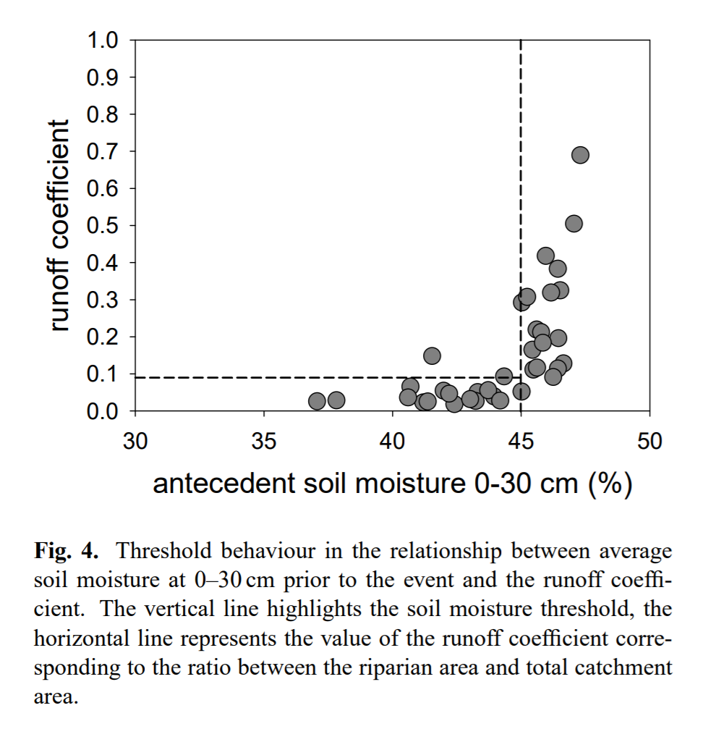
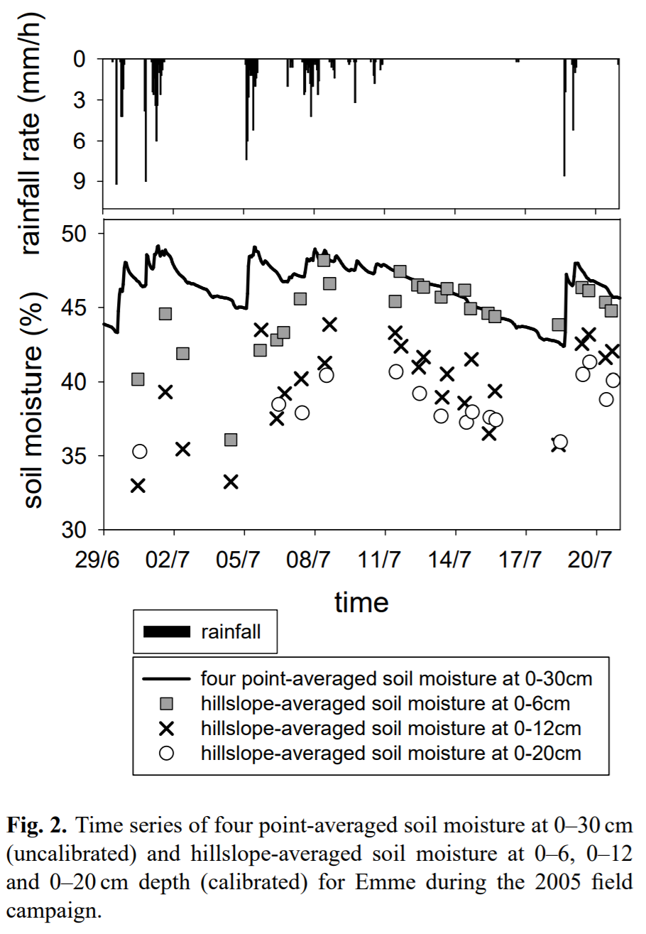
Penna et al. 2011

Slide 6
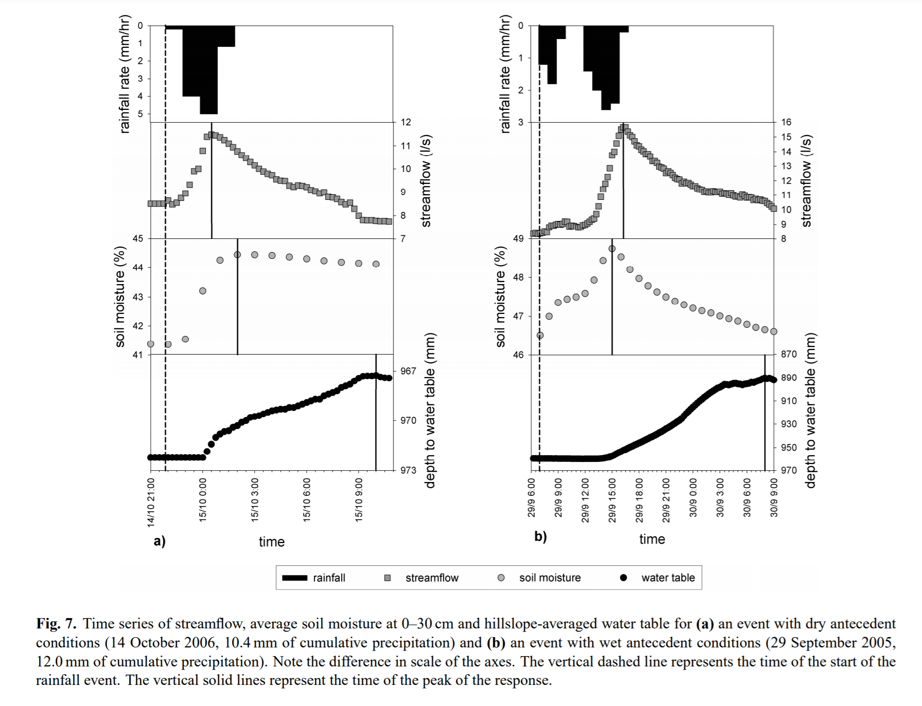

Slide 7
Area and data
Finse, 1222 msl. Oceanic and mild climate for its altitude
Summer/winter temperature around 20/-20 Celsius. Monthy average precipitation around 80 mm. Winds are frequently surpassing 15 m/s (yr.no).
Sparse vegetation and soil coverage → Soil depth: 0.1, 0.3, 0.5, 0.7, 0.9 meters
Forcing data provided in lecture

Slide 8
Model setup
Loop through range of bucket depths
Calculate SEB and water balance for each timestep
Water balance not calculated if surface and ground layer are frozen

Slide 9
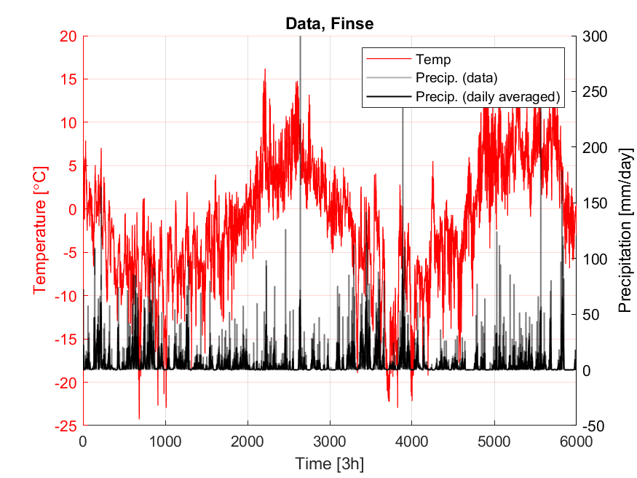
Results – overview

Slide 10
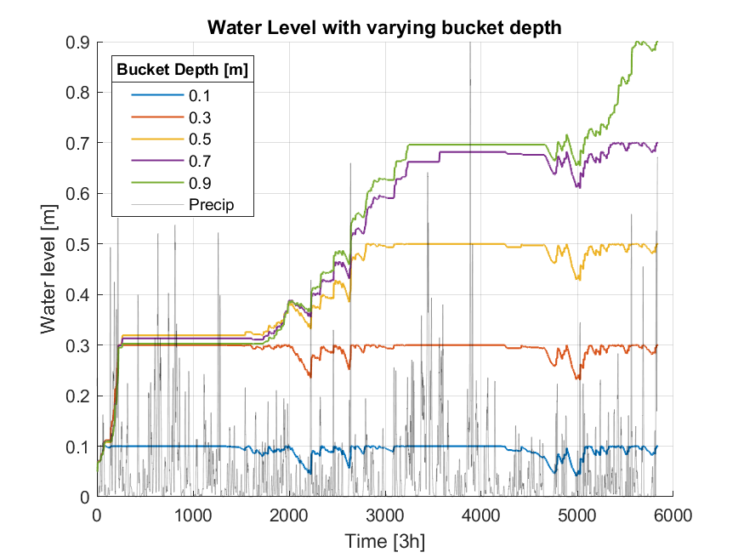
Results

Slide 11
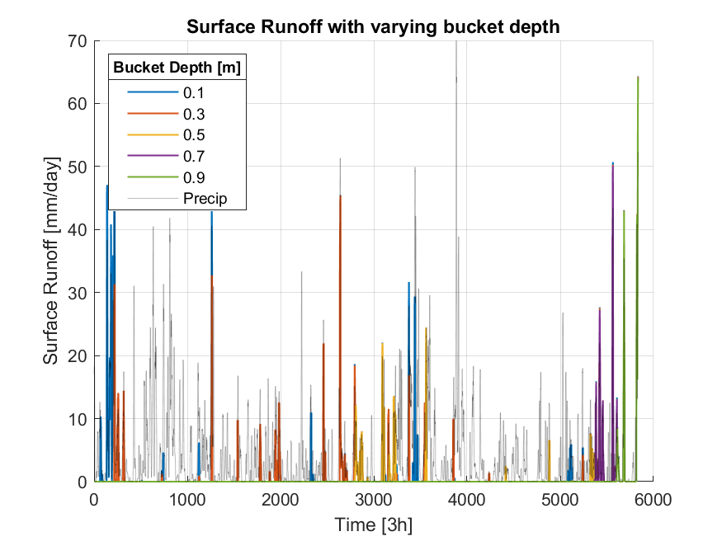
Results

Slide 12
References
D. Penna et al. (2011). The influence of soil moisture on threshold runoff generation process in an alpine headwater catchment.
S. Lawrence Dingman (2015). Physical Hydrology.
Webpage of Finse Alpine Research Center. URL: www.finse.uio.no/about/location/ Visited at 20th Of April 2020.
Yr.no for weather statistics. URL: https://www.yr.no/nb/historikk/graf/1-111123/Norge/Vestland/Ulvik/Finse.

